Slide 1
Lecture:9 Function Overloading
Prepared By: Sumaiya Binte Shahid
Lecturer
Department of CSE, BUBT

Slide 2
Overloading Constructor Functions
There are three main reasons why you will want to overload a constructor function:
to gain flexibility,
to support arrays, and
to create copy constructors.
There must be a constructor function for each way that an object of a class will be created. If a program attempts to create an object for which no matching constructor is found, a compile-time error occurs. This is why overloaded constructor functions are so common to C++ programs.

Slide 3
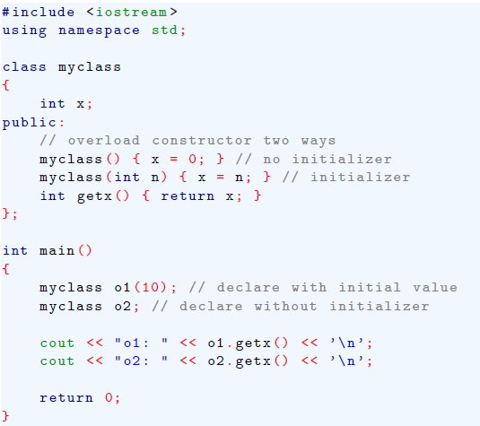
Perhaps the most frequent use of overloaded constructor functions is to provide the option of either giving an object an initialization or not giving it one.
Constructor Overloading

Slide 4
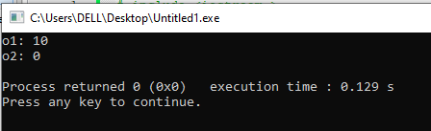
Function Overloading
In the last program, o1 is given an initial value, but o2 is not. If you remove thee constructor that has the empty argument list, the program will not compile because there is no constructor that matches a non-initialized object of type myclass. The reverse is also true. If you remove the parameterized constructor, the program will not compile because there is no match for an initialized object. Both are needed for this program to compile correctly.

Slide 5
Overloading Constructor Functions
Another common reason constructor functions are overloaded is to allow both individual objects and arrays of objects to occur within a program.
It is fairly common to initialize a single variable, but it is not as common to initialize an array.
Thus, to allow non-initialized arrays of objects along with initialized objects, you must include a constructor that supports initialization and one that does not.
By providing both a parameterized and a parameterless constructor, your program allows the creation of objects that are either initialized or not as needed.
Of course, once you have defined both parameterized and parameterless constructors you can use them to create initialized and non-initialized arrays.

Slide 6
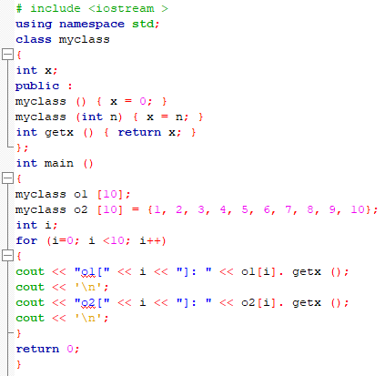
Constructor Overloading

Slide 7
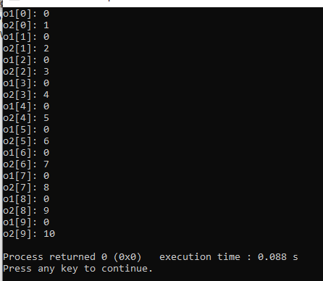
Constructor Overloading
In this example, all elements of o1 are set to 0 by the constructor function. The elements of o2 are initialized as shown in the program.

Slide 8
Overloading Constructor Functions
Another reason for overloading constructor functions is to allow the programmer to select the most convenient method of initializing an object. To see how, first examine the next example, which creates a class that holds a calender date. It overloads the date() constructor two ways. One form accepts the date as a character string. In the other form, the date is passed as three integers.
Although it is possible to overload a constructor as many times as you want, doing so excessively has a destructuring effect on the class. From a stylistic point of view, it is best to overload a constructor to accommodate only those situations that are likely to occur frequently.

Slide 9
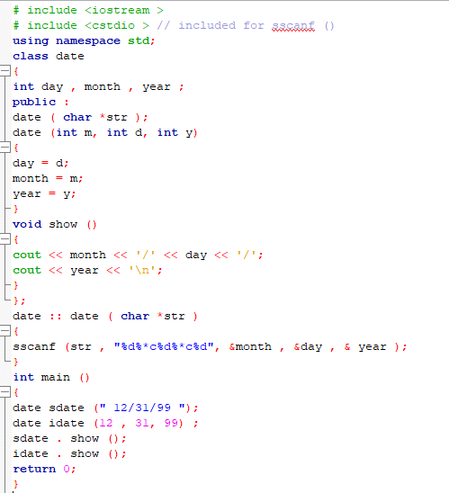
Constructor Overloading

Slide 10

Constructor Overloading
The advantage of overloading the date() constructor, as shown in this program, is that you are free to use whichever version most conveniently fits the situation in which it is being used. For example, if a date object is being created from user input, the string version is the easiest to use. However, if the date object is being constructed through some sort of internal computation, the three-integer parameter version probably makes more sense.

Slide 11
Overloading Constructor Functions
There is one other situation in which you will need to overload a class's constructor function: when a dynamic array of that class will be allocated. As you should recall from the preceding chapter, a dynamic array cannot be initialized. Thus, if the class contains a constructor that takes an initializer, you must include an overloaded version that takes no initializer.

Slide 12
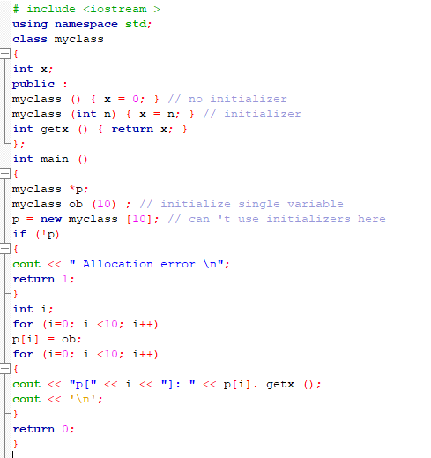
Constructor Overloading

Slide 13
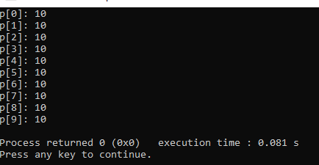
Constructor Overloading
Without the overloaded version of myclass() that has no initializer, the new statement would have generated a compile-time error and the program would not have been compiled.

Slide 14
The Overload Anachronism
When C++ was first invented, the keyword overload was required to create an overloaded function. Although overload is now obsolete and no longer supported by modern C++ compilers, you may still see overload used in old programs, so it is a good idea to understand how it was applied. The general form of overload is shown here,
overload func_name ;
where func-name is the name of the function to be overloaded. This statement must precede the overloaded function declarations.

Slide 15
Using Default Arguments
There is a feature of C++ that is related to function overloading. This feature is called the default argument, and it allows you to give a parameter a default value when no corresponding argument is specified when the function is called. For example, this function gives its two parameters default values of 0:
void f(int a=0, int b=0) ;
Notice that this syntax is similar to variable initialization. This function can now be called three different ways.
First, it can be called with both arguments specified.
f(10 , 99); // a is 10, b is 99

Slide 16
Using Default Arguments
Second, it can be called with only the first argument specified. In this case, b will default to 0.
f (10) ; // a is 10, b defaults to 0
Finally, f()can be called with no arguments, causing both a and b to default to 0.
f(); // a and b default to 0
All default parameters must be to the right of any parameters that don't have defaults. Once you start giving default values, all parameters to the right must also have defaults. For instance:
voidf(int a, int b = 10, int c); // Invalid
void f(int a, int b = 10, int c = 20); // Valid

Slide 17
Using Default Arguments
If you want to specify b but leave a as default, it's not possible. You must provide values for parameters from left to right. For example:
Valid: f(10, 99) or f(10)
Invalid: There's no way to call f where b is set, but a uses its default.
One other point about default arguments: they must be constants or global variables. They cannot be local variables or other parameters.
Constants (e.g., 0, 10)
Global variables (e.g., int x = 5; void f(int a = x);)
Not allowed: Local variables or other parameters.

Slide 18
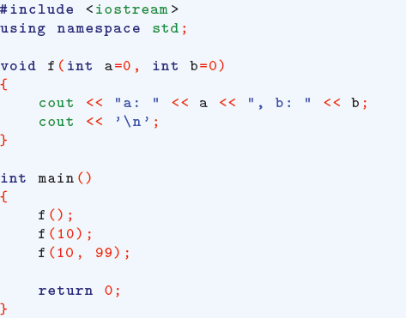
Using Default Arguments
a: 0, b: 0
a: 10, b: 0
a: 10, b: 99

Slide 19
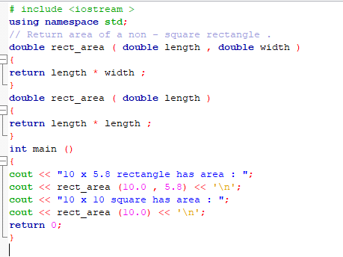
Using Default Arguments

Slide 20
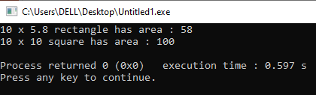
Using Default Arguments
In this program, rect area() is overloaded two ways. In the first way, both dimensions of a rectangle are passed to the function. This version is used when the rectangle is not a square. However, when the rectangle is a square, only one argument need to be specified, and the second version of rect area() is called.

Slide 21
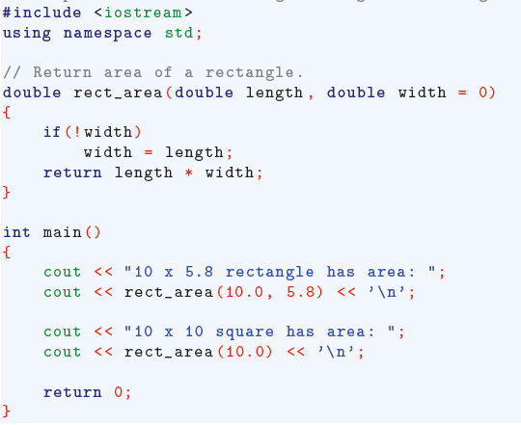
Using Default Arguments
If you think about it, it is clear that in this situation there is really no need to have two different functions. Instead, the second parameter can be defaulted to some value that acts as a flag to rect_area(). When this value is seen by the function, it uses the length parameter twice. Here is an example of this approach:

Slide 22
Using Default Arguments
Here 0 is the default value of width. This value was chosen because no rectangle will have a width of 0. Thus, if this default value is seen, rect area() automatically uses the value in length for the value of width. As this example shows, default arguments often provide a simple alternative to function overloading.

Slide 23
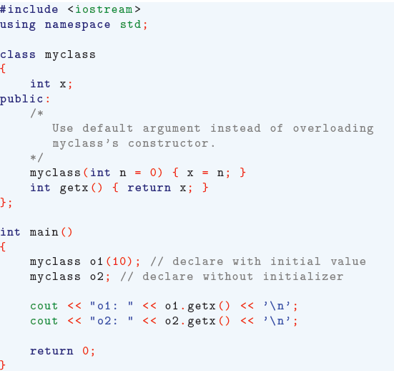
Using Default Arguments
It is not only legal to give constructor functions default arguments, it is also common. As you saw earlier in this chapter, many times a constructor is overloaded simply to allow both initialized and uninitialized objects to be created. In many cases, you can avoid overloading a constructor by giving it one or more default arguments. For example, examine this program:

Slide 24
Overloading and Ambiguity
When you are overloading functions, it is possible to introduce ambiguity into your program. Overloading-caused ambiguity can be introduced through
type conversions,
reference parameters, and
default arguments.
Further, some types of ambiguity are caused by the overloaded functions themselves. Other types occur in the manner in which an overloaded function is called. Ambiguity must be removed before your program will compile without error.

Slide 25
Overloading and Ambiguity
One of the most common types of ambiguity is caused by C++'s automatic type conversion rules.
In C++, when you call a function with an argument of a different, but compatible type, the compiler automatically converts the argument to the function's parameter type.
When you have overloaded functions (multiple functions with the same name but different parameter types), the compiler decides which function to call based on the argument type.
But if the argument type is ambiguous (i.e., can be converted into multiple valid types), the compiler gets confused.

Slide 26
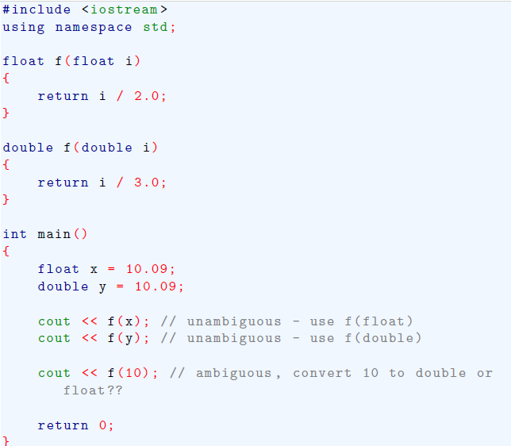
Overloading and Ambiguity
When you call f(10), the value 10 is an integer. The compiler can convert 10 into either:
float for f(float)
double for f(double)
Both conversions are valid, so the compiler doesn’t know which function to pick. This is called an ambiguity error.

Slide 27
Overloading and Ambiguity
Automatic type conversion can sometimes cause the compiler to face multiple valid options when choosing an overloaded function. To avoid this, you can explicitly cast the argument:
cout << f((float)10); // Calls f(float)
cout << f((double)10); // Calls f(double)

Slide 28
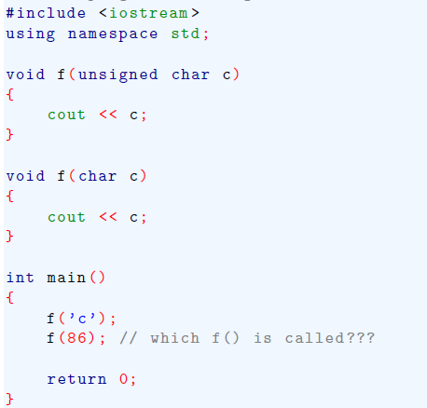
Overloading and Ambiguity
Here is another example of function overloading that is not ambiguous in and of itself. However, when this function is called with the wrong type of argument, C++'s automatic conversion rules cause an ambiguous situation,

Slide 29
Overloading and Ambiguity
Why This Happens:
char and unsigned char are both valid target types for integer values like 86.
Since C++ automatic type conversion rules don't prioritize one over the other in this case, it results in an ambiguity error.
Solution:
Even though the functions themselves are not ambiguous, calling them with a value like 86 (which can convert to multiple valid types) causes ambiguity.
To fix this, explicitly cast the argument:
f((unsigned char)86); // Calls f(unsigned char)
f((char)86); // Calls f(char)

Slide 30
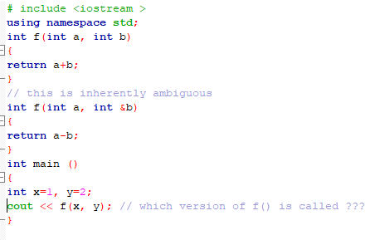
Overloading and Ambiguity
One type of ambiguity is caused when you try to overload functions in which the only difference is the fact that one uses a reference parameter and the other uses the default call-by-value parameter. Given C++'s formal syntax, there is no way for the compiler to know which function to call.

Slide 31
Overloading and Ambiguity
Why This Happens?
When f(x, y) is called, the compiler has no way to decide which version of f() to use:
Should it use f(int a, int b) where y is passed by value?
Or should it use f(int a, int &b) where y is passed by reference?
Since both seem valid, the compiler flags this as an error.
Avoid overloading functions where the only difference is between value and reference parameters, as it leads to ambiguity and compilation errors.

Slide 32
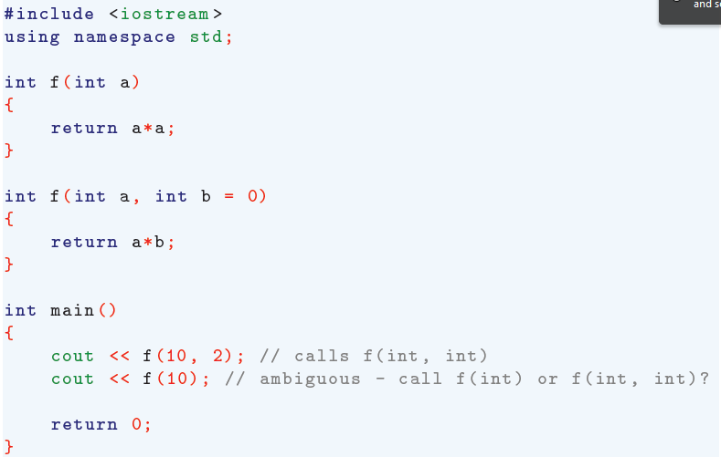
Overloading and Ambiguity
Another type of ambiguity is caused when you are overloading a function in which one or more overloaded functions use a default argument. Consider this program:

Slide 33
Overloading and Ambiguity
First call (f(10, 2)):
Clear match for f(int a, int b) .
No problem here.
Second call (f(10)):
Two possible interpretations:
Call Version 1 (f(int a)) — since f(10) matches f(int).
Call Version 2 (f(int a, int b)) — with b defaulting to 0.
Since both interpretations are valid, the compiler can't decide which one to use, causing ambiguity.
***Avoid overloading functions where one version can be confused with another due to default arguments. This ensures that every function call has a clear and unambiguous target.

Slide 34

Thank You

